Slide 1
Final Project Presentation
AR Furniture Placement App
By: Sarah Abbadi, Alexander Emory, Ameya Deshmukh, Anushka Rao, Chase Dillard, Shreyas Sakhalkar

Slide 2
Introduction
Problem
Online
Can only see pictures of furniture before buying
In store
Retail stores are inconvenient
Picking furniture is time consuming
Whether you buy online or in store, you don’t know how the furniture will look in your home until it arrives.
Solution
Preview furniture with AR technology
Convenient mobile browsing
Quickly find furniture with search feature
Our mobile storefront with AR integration allows you to preview furniture in real time and purchase it all in one app.

Slide 3
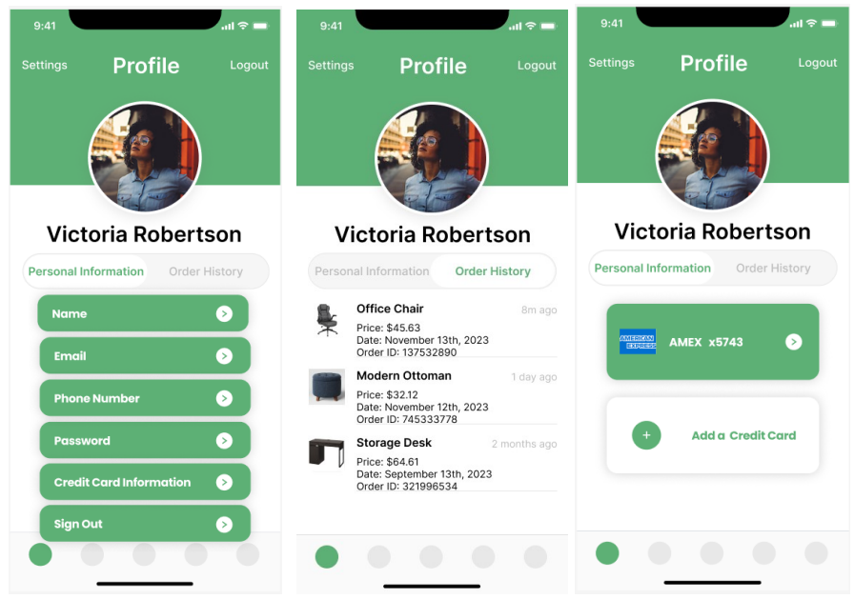
User Interface
User Profile

Slide 4
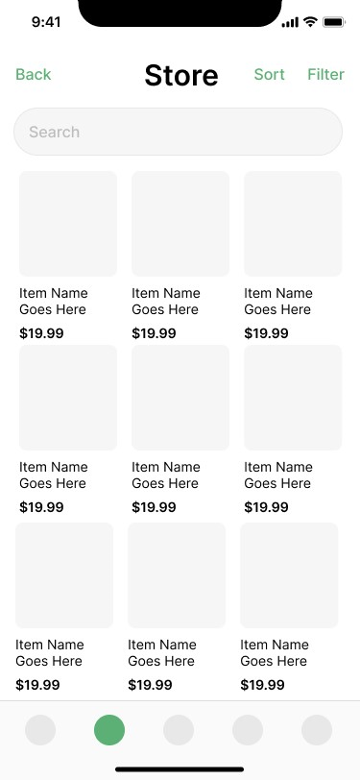
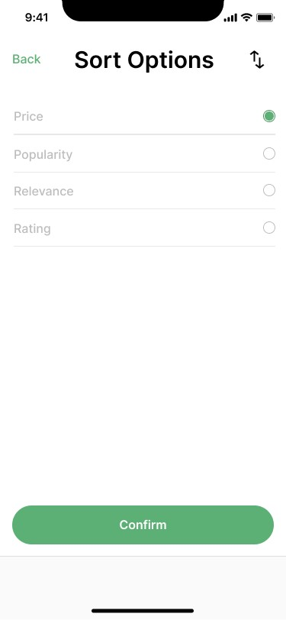
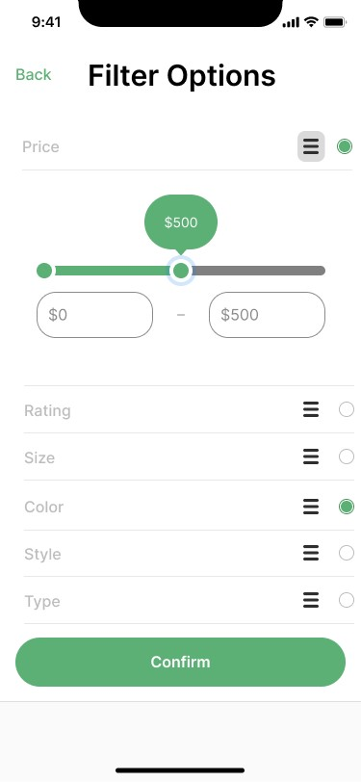
User Interface
Product Search
Sort Selection
Price Selection
Filter Selection

Slide 5
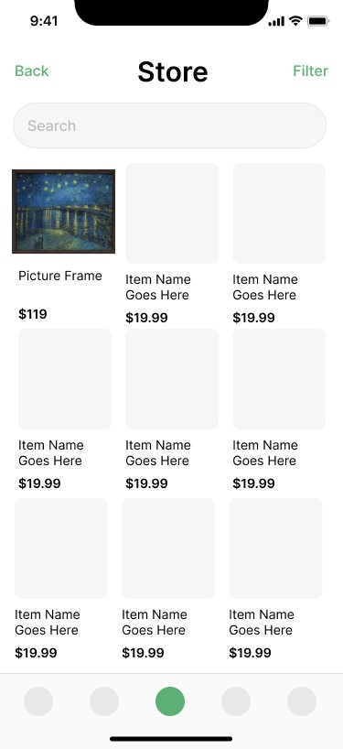
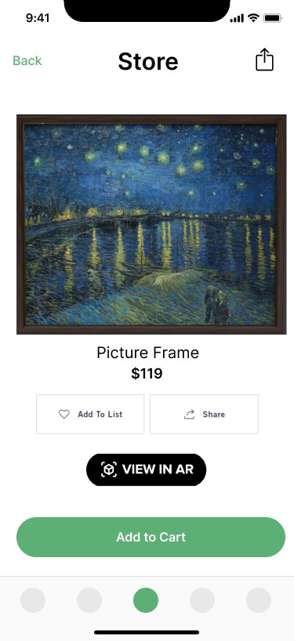
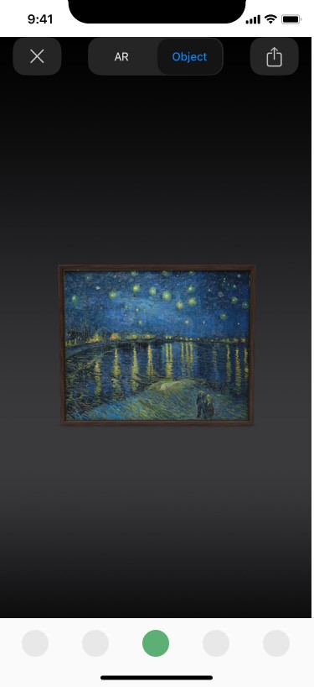
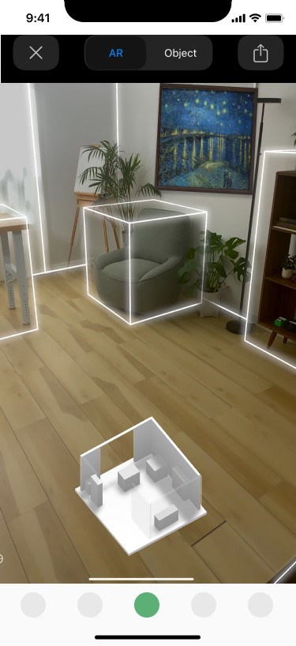
User Interface
Catalog View
Item View
Object View
AR View

Slide 6
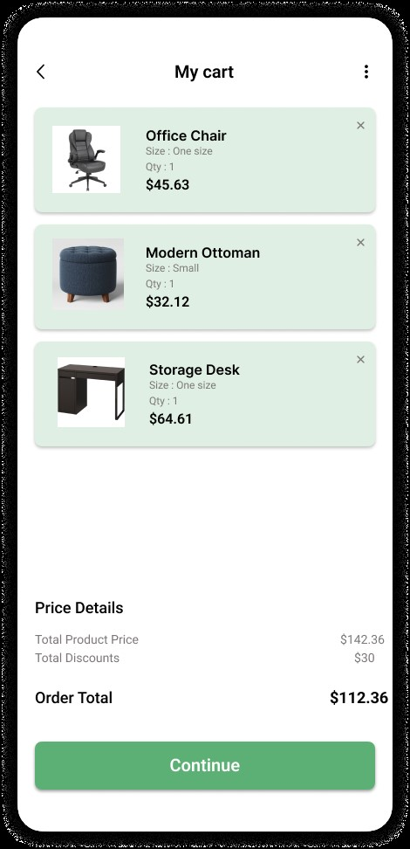
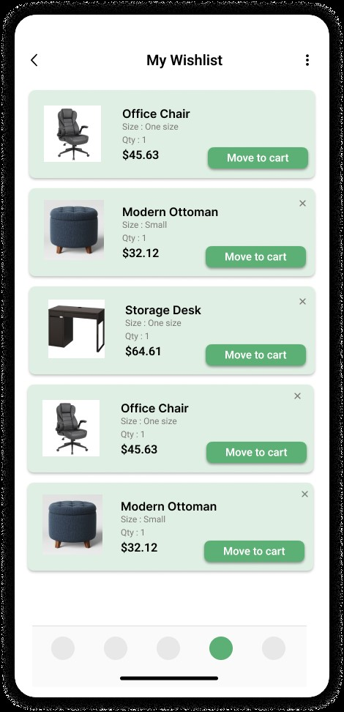
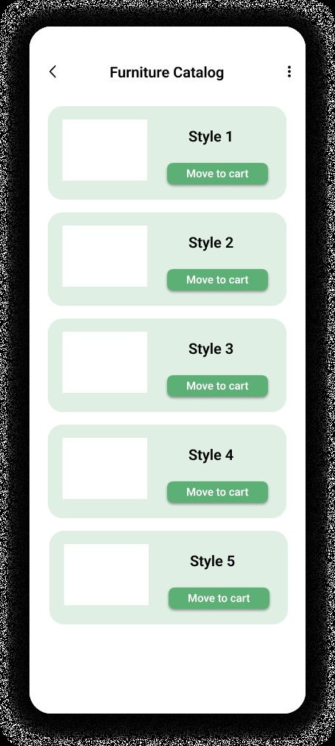
User Interface
Cart View
Wishlist View
Furniture Catalog

Slide 7
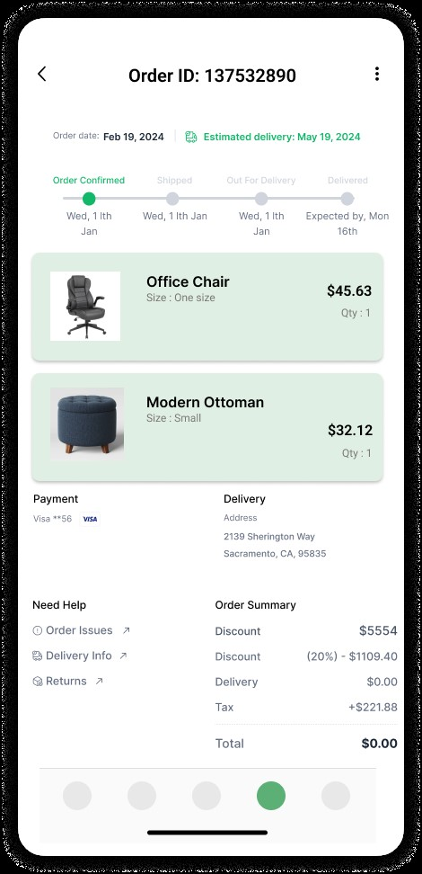
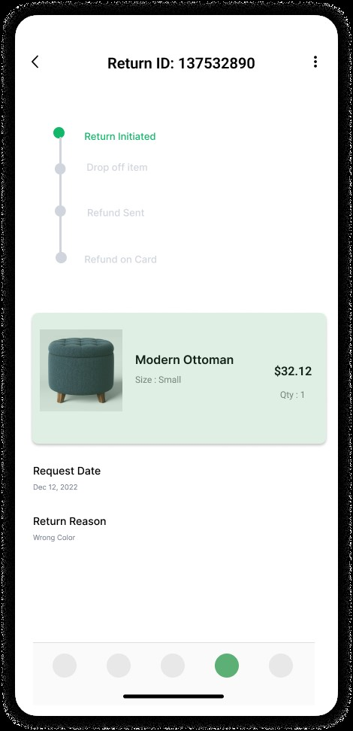
User Interface
Tracking Order
Return Order

Slide 8
Most Appealing Features
Augmented Reality Feature
Product Search
1
2
3
4
Space Sharing
Sorting Feature

Slide 9
Augmented Reality Feature
View Furniture Item in AR
Toggle between Object View and AR View
Place item and detect collisions

Slide 10
Space Sharing
User can share the 3D scan of their environment which includes the furniture item and share it with friends
User can save the captured space in their account and view them later

Slide 11
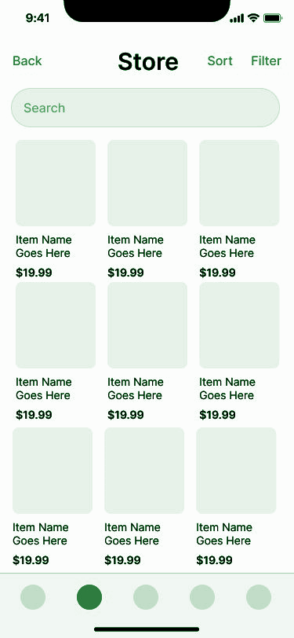
Product Search
01
02
03
Functionality
Helps user find the most relevant item as per their description.
Features Provided
Features like sort and filter makes the app more user friendly.
Advantages
Helps users swiftly discover furniture items

Slide 12
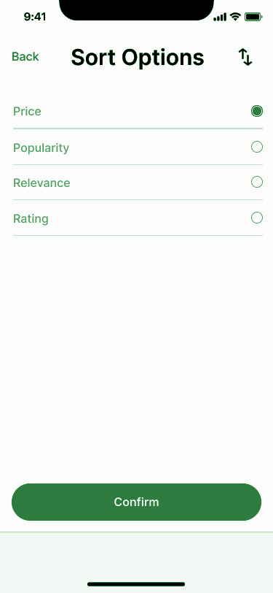
Sorting Feature
01
02
03
Functionality
To ease the shopping experience users can sort the displayed items based on their exact criteria
Types of Sorting Offered
Different options provided to filter and sort like Price, Popularity, Relevance and Rating
Advantages
The sorting feature streamlines the furniture discovery process

Slide 13
Major Challenges
System Design Collaboration
AR Integration
Difficulties with implementing AR into our mobile app due to lack of experience
Difficulty creating a system design for app functionalities while collaborating
Consistent Design Format
Lack of User Input
Lack of knowledge of user’s needs and preferences when using app, and lack of access to user feedback or testing
Trouble keeping consistent format across design deliverables for all functionalities

Slide 14
Solutions
System Design Collaboration
AR Integration
Conducting research of AR Integration helped us understand how to integrate AR API’s into our app
Utilizing design tools with real-time collaborative features such as Figma and LucidCharts
Consistent Design Format
User Input
Having design reviews by every member before submitting
Attempting to keep design consistencies with aspects such as font, color and format
Developing fully dressed use cases helped us understand user’s needs and preferences a little better

Slide 15
Lessons Learned
01
02
03
API Integration
Furthered our knowledge of API Integration and Documentation
Collaboration
Utilization of real-time collaboration tools
Strong communication - team meetings
Design Process
New aspects to the software design process
Use case studies, Diagrams, UI Design

Slide 16
Summary
Revolutionary Idea
AR-assisted furniture shopping
Roadblocks
System design and user input
Solutions
Extra planning and collaboration

Slide 17
Thanks!
Do you have any questions?
GitHub Link

